Slide 1
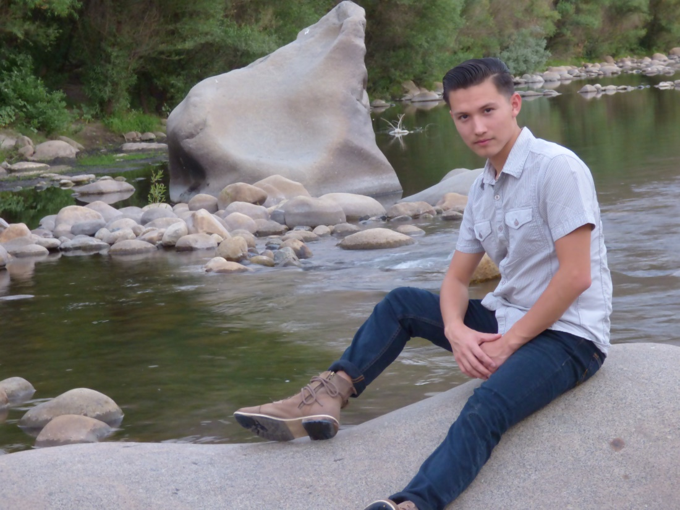
Diego Montana

Slide 2
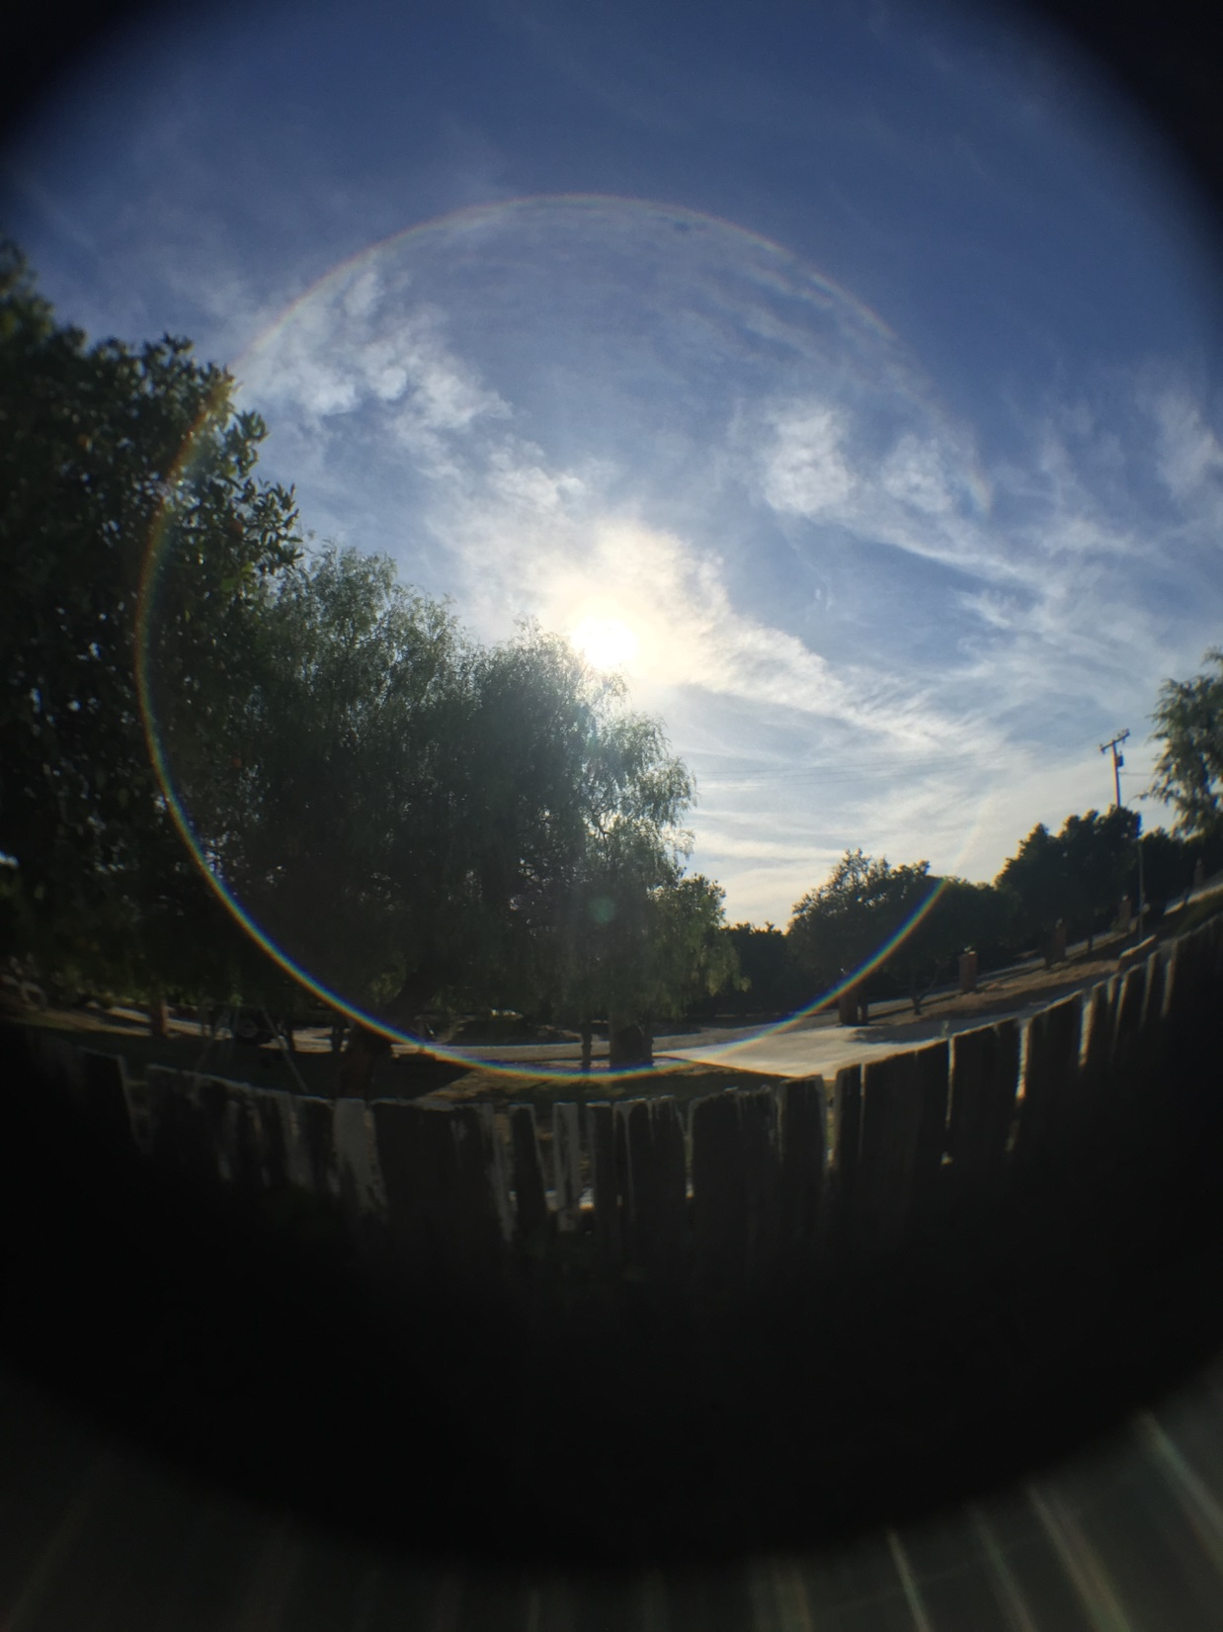
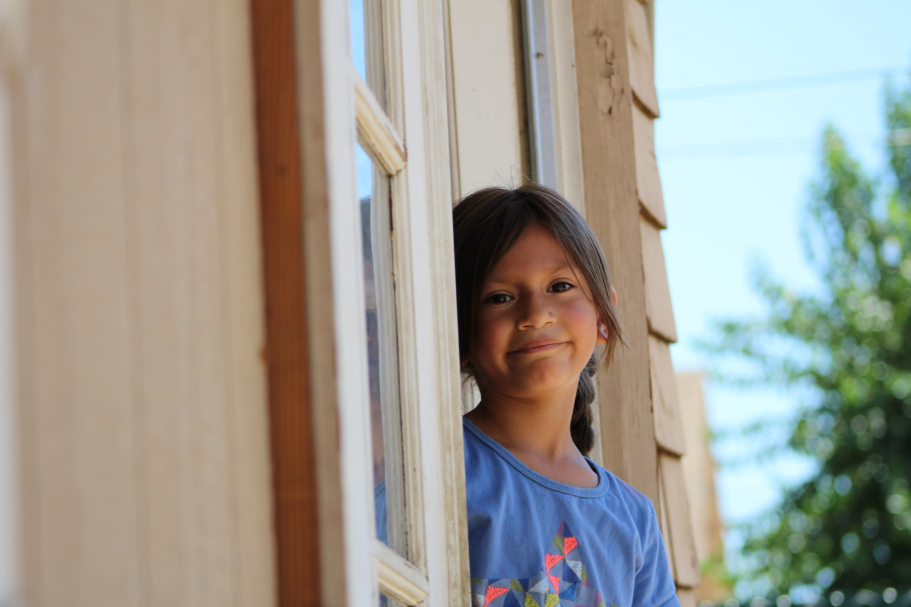
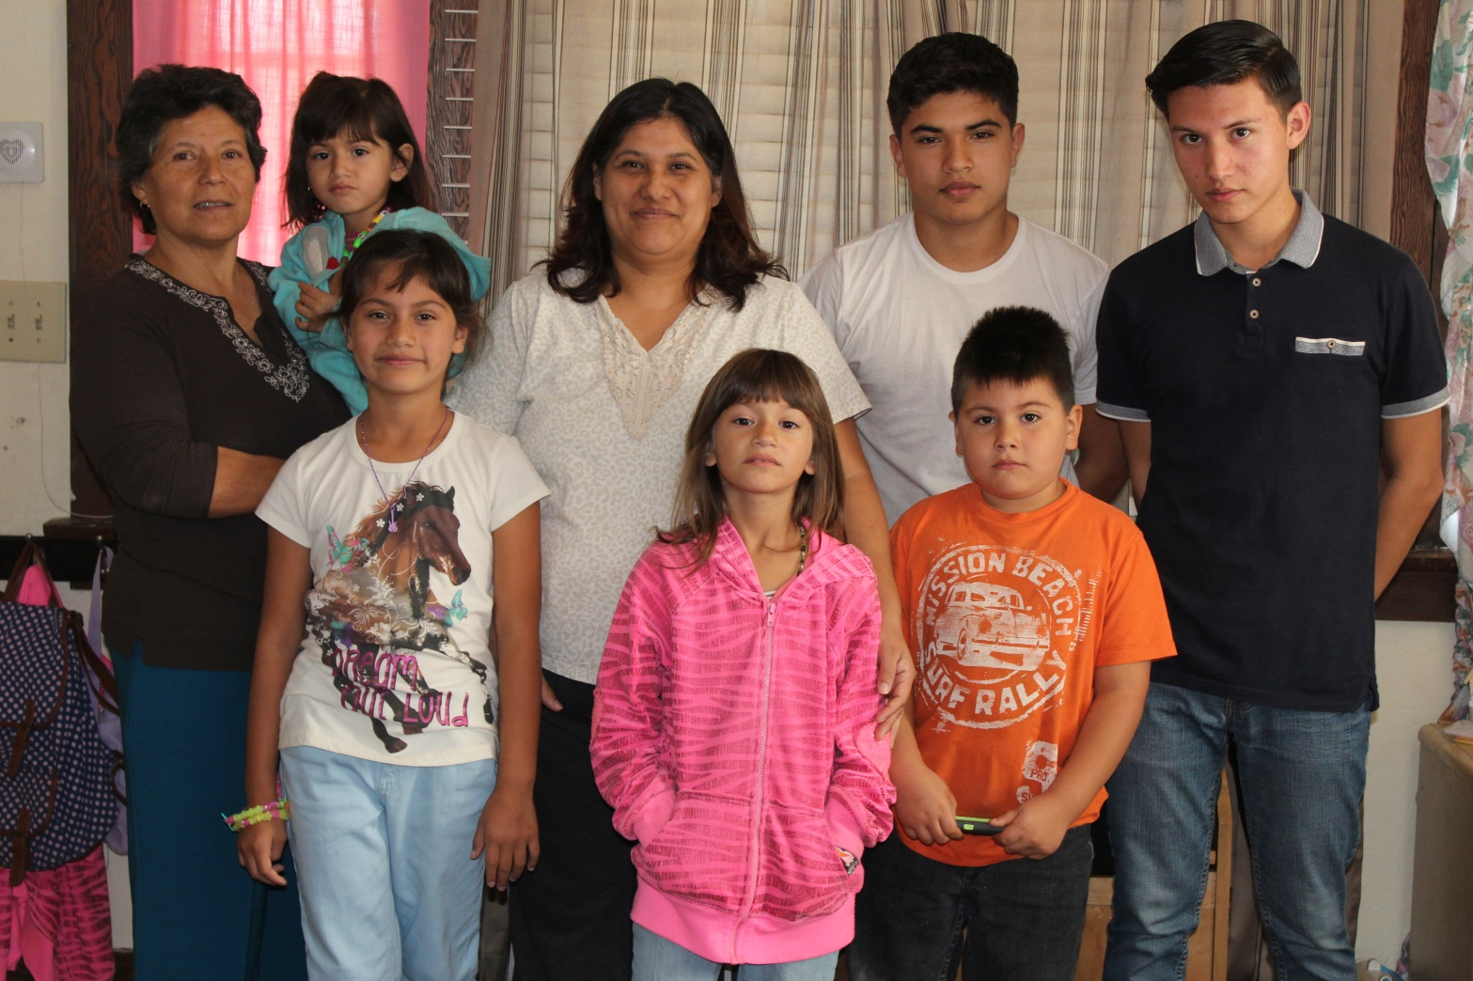
About Me
Born and Raised in Lindsay
Oldest child
Bilingual
Photography

Slide 3
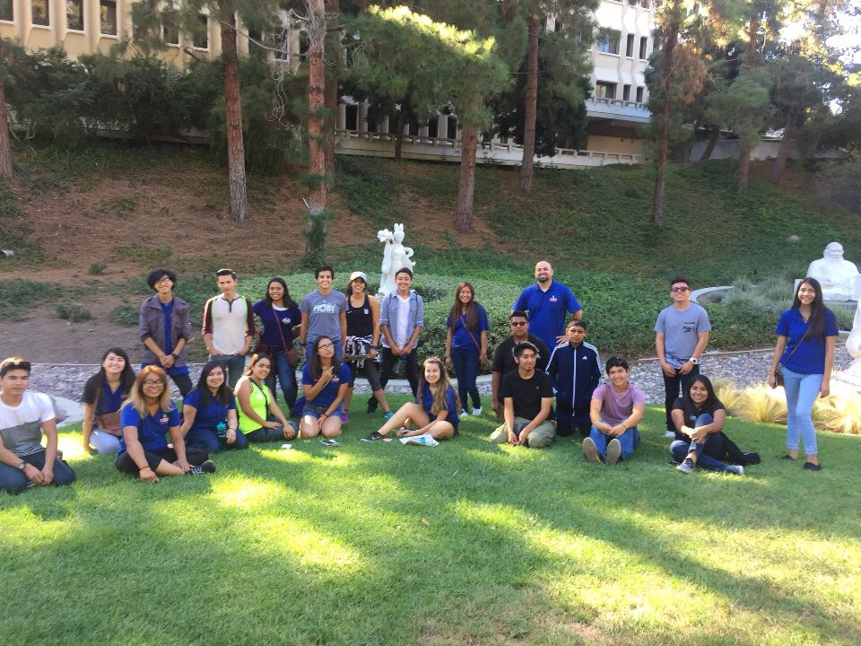
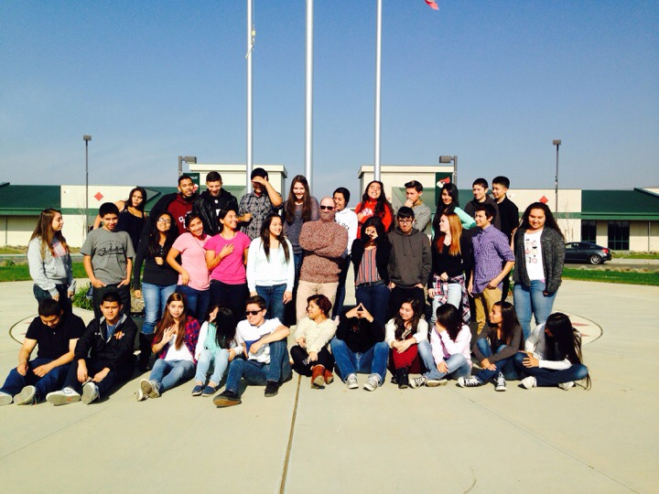
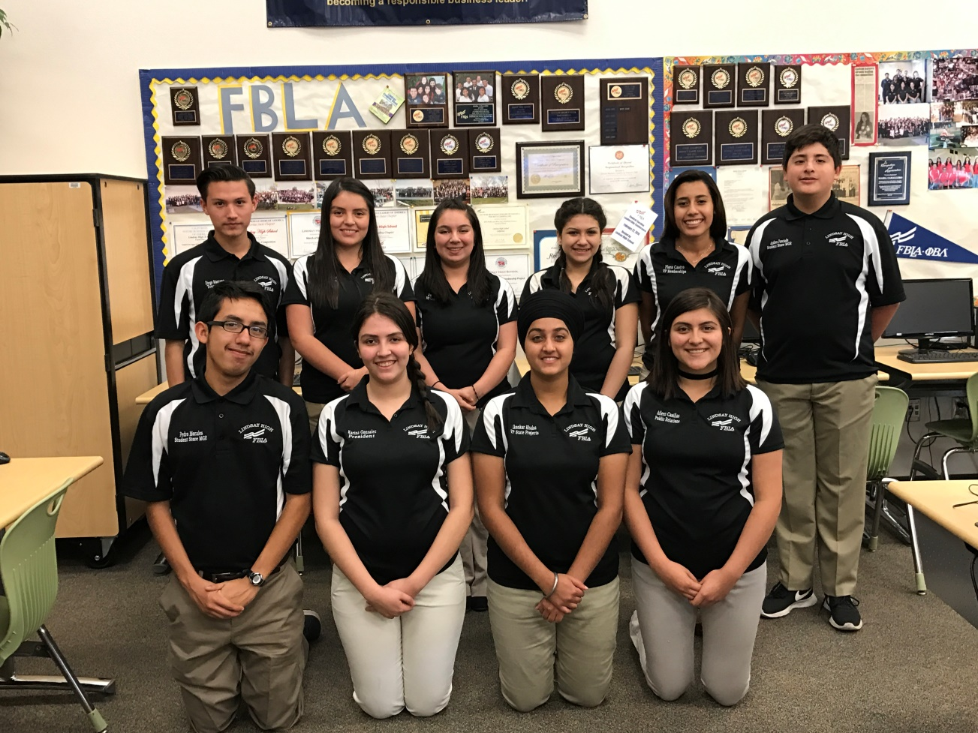
High School Experience
Different Clubs
FBLA
AVID
TRIO
ASB
Academics- Good

Slide 4
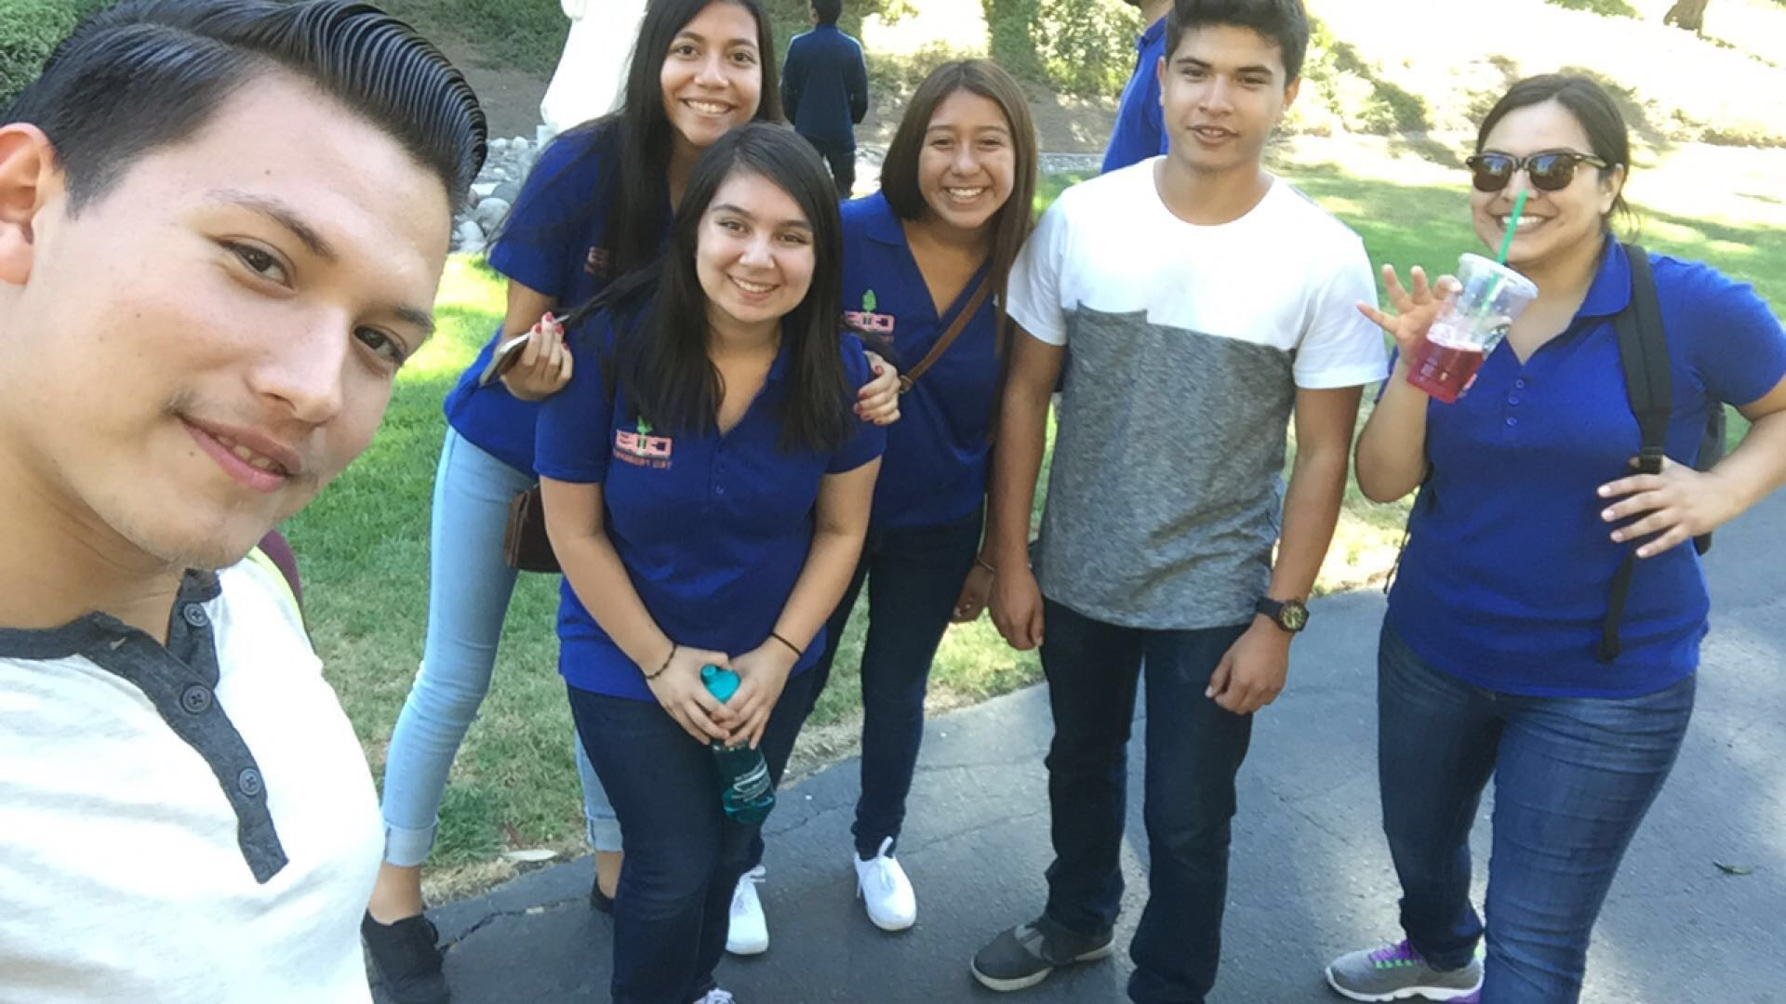
Job Shadow
Education Field
Maria Sanchez - Student Service Specialist
Still interested?

Slide 5
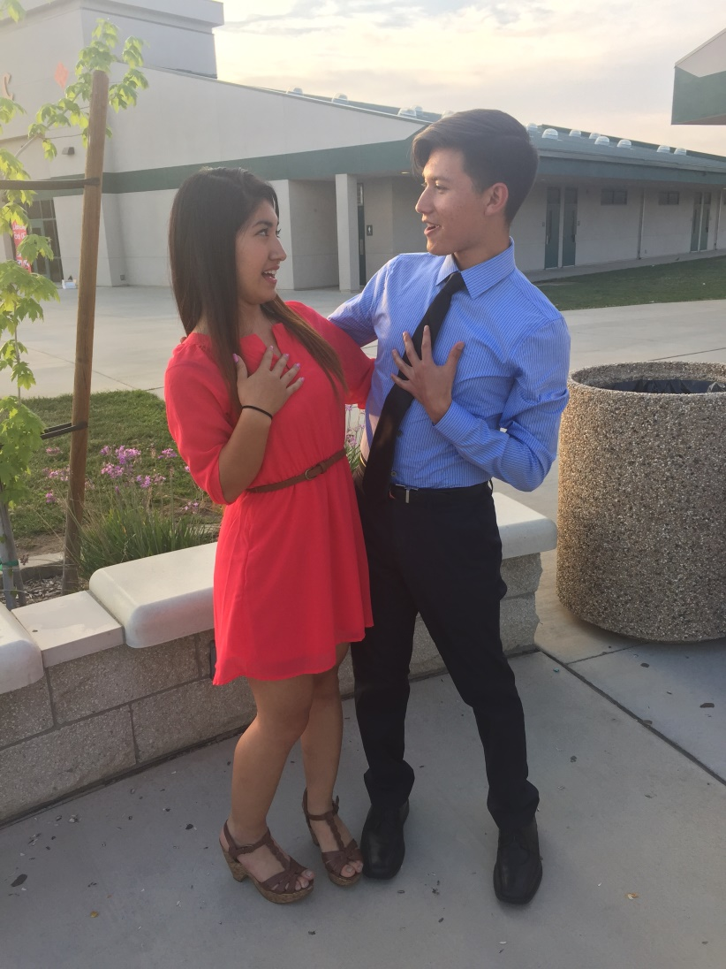
Pathway
French
3 years
Loved learning

Slide 6
Post-High School Plans
Applied to 9 UC’s, 8 CSU’s, and 1 Junior college
Major in the Business or Education Field

Slide 7
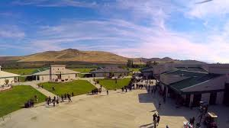
Leaving LHS
Inspirational Teachers
Guss
Performance Based System (PBS)
Struggled
Became more responsible
Independent

Slide 8
Questions?

